Slide 1
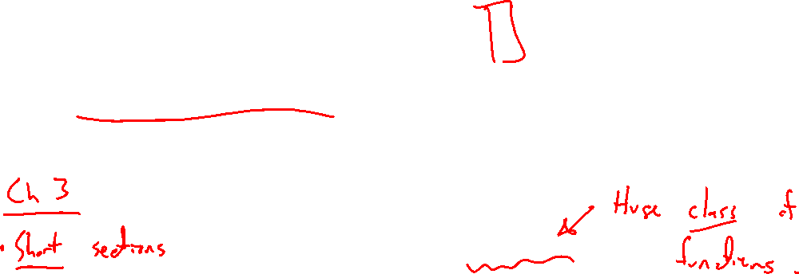
Section 3.2 Polynomial Functions and Their Graphs
Lecture 1
Generalizing to polynomials
Notes:
Note, skip 2.5, more on lines, focus is on thinking linear. Similar ideas to previous lectures

Slide 2

Homework Submission to Canvas
Preview of section
Skim the section in text and write a short paragraph summary.
Give a bulleted list of all important definitions, theorems, and formulas without details.
Notes on video lectures
Take notes on everything written on slides including all details, worked examples, on-own activities, as well as your own thoughts and questions.
Try on-own activities first, then write down provided solution next to it for comparison.
Worked examples from the text
Write down the problem and attempt without looking at the solution.
Use the solution to write the best explanation you can.
Solutions to textbook exercises
Model approaches and explanations given in the video lectures and textbook examples.
Final reflection of section
List the key takeaways to remember as a bulleted list.

Slide 3
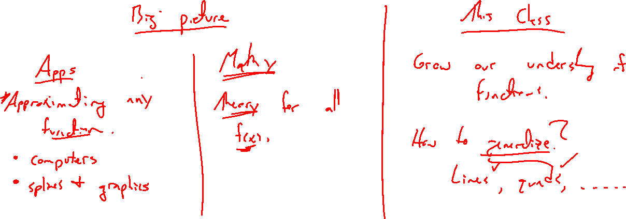
Why Polynomial Functions?
Notes:
Computers, splines and yoda, Taylor series and math theory
Mathy way to think in terms of generalization

Slide 4
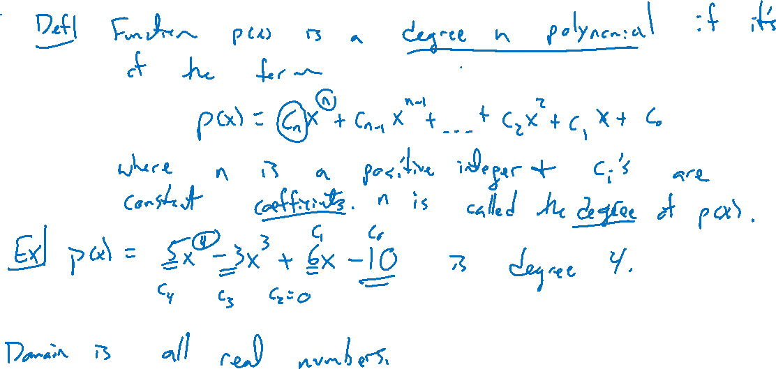
Polynomial Functions
Notes:
General definition, coefficients, degree, domain, range, standard form
Graphs: linear, quad, cubic, quart, …. graph to dev intuition
Degree n can have at most (n-1) extrema)

Slide 5
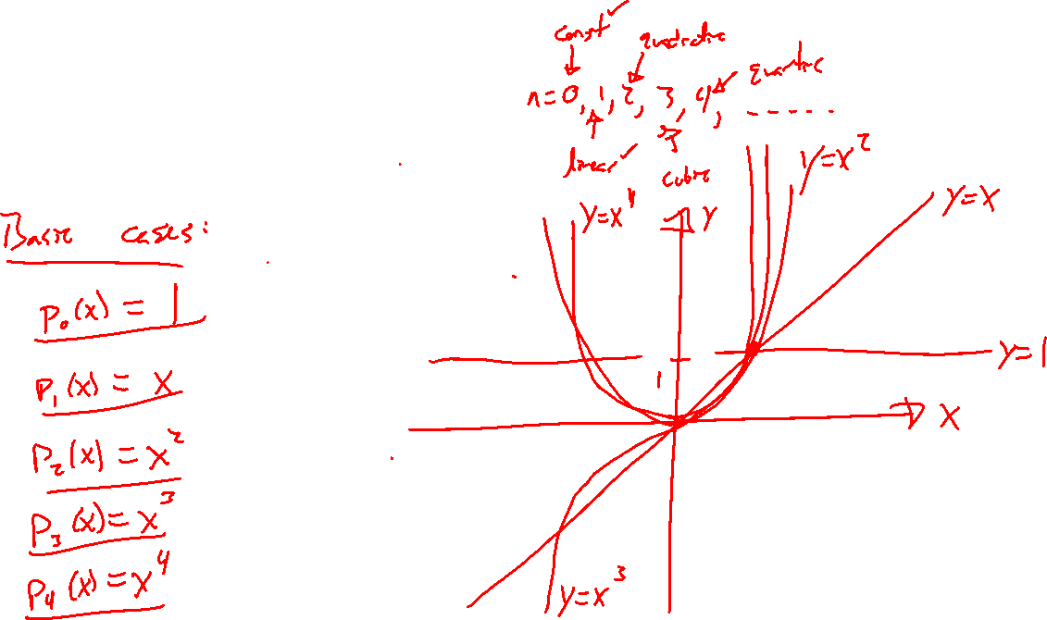
Graphs of Polynomials

Slide 6
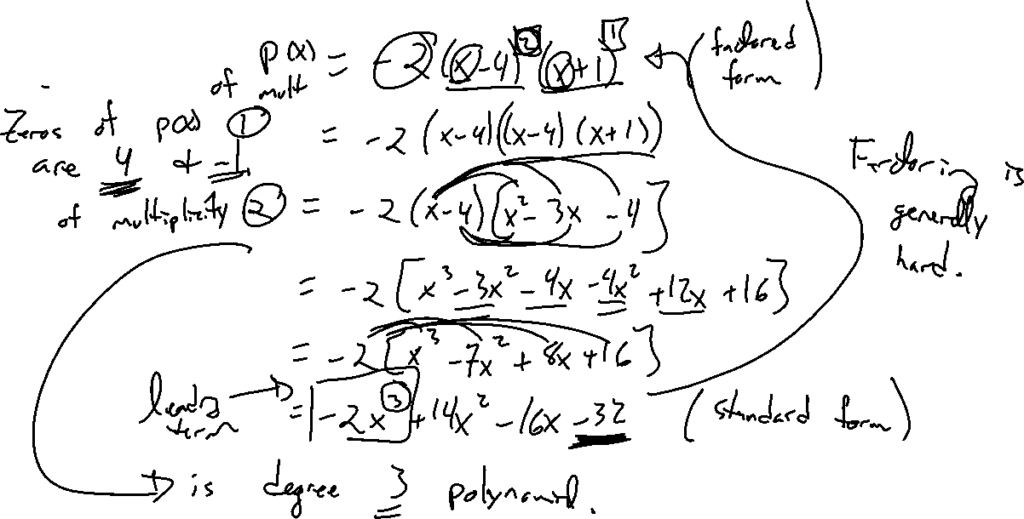
Example:
Notes:
Ex: y=-2(x-4)^2(x+1) as factored form. Find degree, leading coefficient, zeros, multiplicity
Real / complex zeros
Graph in desmos, end behavior

Slide 7
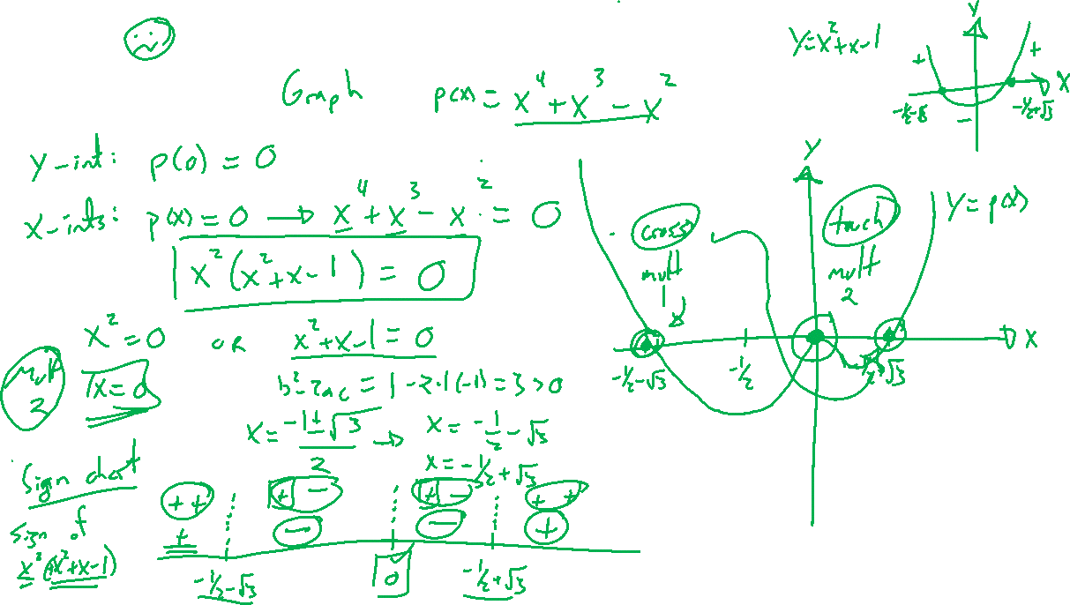
Example:
Notes:
Factor completely and sketch the graph.
Talk domain, range, end behaviour, multiplicity
Some features need calculus to get all details
F(x) = x^4+x^3-x^2
Take advantage of multiplicity

Slide 8
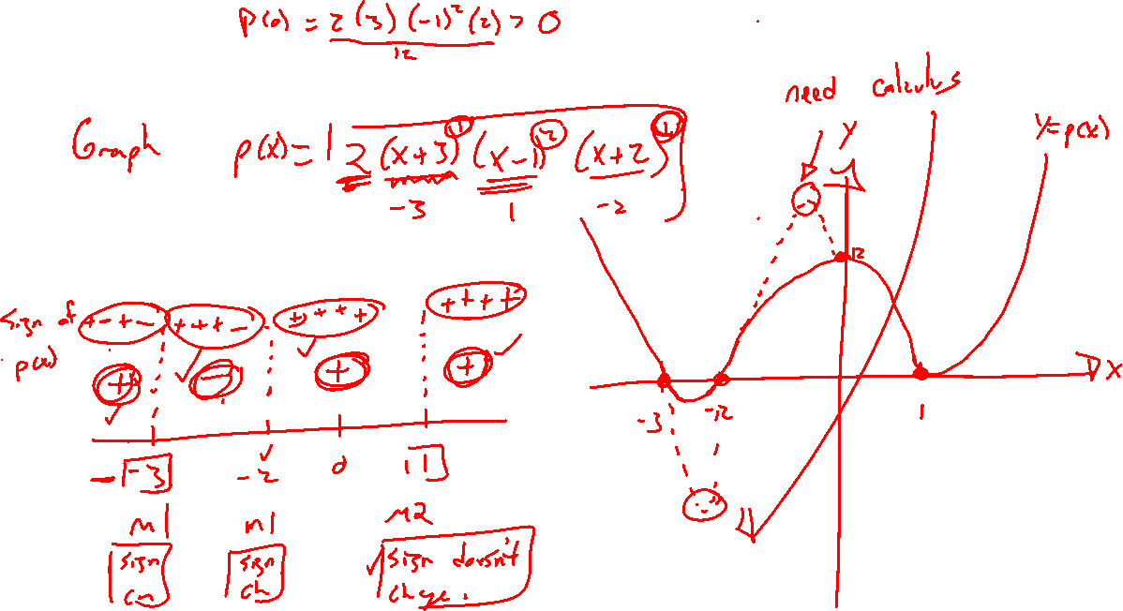
Example: Try on Own
Notes:
F(x) = 2(x+3)(x-1)^2(x-2)

Slide 9

Textbook Examples and Exercises
Rework examples 1, 3, 4, 6, 8 in the text. Steps:
Write down a problem.
Close the book and attempt on own.
Check / correct your solution against the text solution.
If needed, rewrite the problem to be of the quality of the text solution.
Complete exercises 11, 17, 29, 35, 79
Write solutions of the same quality as in lecture and text solutions.
Check your solution against the answer in the back of the book.

Slide 10

Homework Submission to Canvas
Preview of section
Skim the section in text and write a short paragraph summary.
Give a bulleted list of all important definitions, theorems, and formulas without details.
Notes on video lectures
Take notes on everything written on slides including all details, worked examples, on-own activities, as well as your own thoughts and questions.
Try on-own activities first, then write down provided solution next to it for comparison.
Worked examples from the text
Write down the problem and attempt without looking at the solution.
Use the solution to write the best explanation you can.
Solutions to textbook exercises
Model approaches and explanations given in the video lectures and textbook examples.
Final reflection of section
List the key takeaways to remember as a bulleted list.

